Slide 1
R3: Redefining the Foundations of Finance Blockchain/Distributed Ledger Technology

Slide 2

R3’s Global Reach
What began as an exploratory exercise by a small group of investment banks, has developed into a world wide connected consortium spanning finance, banking, insurance, and payments
With 100+ R3 professionals combined with the DLT teams from over 80+ members resulting in an unparalleled team of over 1400 people across 22 countries dedicated to DLT collaboration
R3 has a fast growing team with offices in:
New York
London
Seoul
Singapore
Switzerland
Sydney
Taipei
Tokyo
Washington DC

Slide 3
World Economic Forum Report on DLT
R3 Lab & Research Centre - confidential.

Slide 4
World Economic Forum Report on DLT
R3 Lab & Research Centre - confidential.
Notes:
The World Economic Forum describes Blockchain technology as follows: Blockchain or distributed ledger technology (DLT) is a technological protocol that enables data to be exchanged directly between different contracting parties within a network without the need for intermediaries. The network participants interact with encrypted identities (anonymously); each transaction is then added to an immutable transaction chain and distributed to all network nodes.

Slide 5
World Economic Forum Report on DLT.

Slide 6
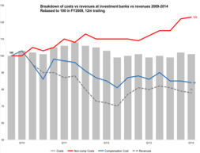
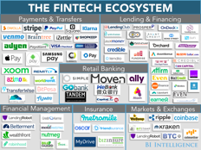
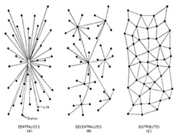
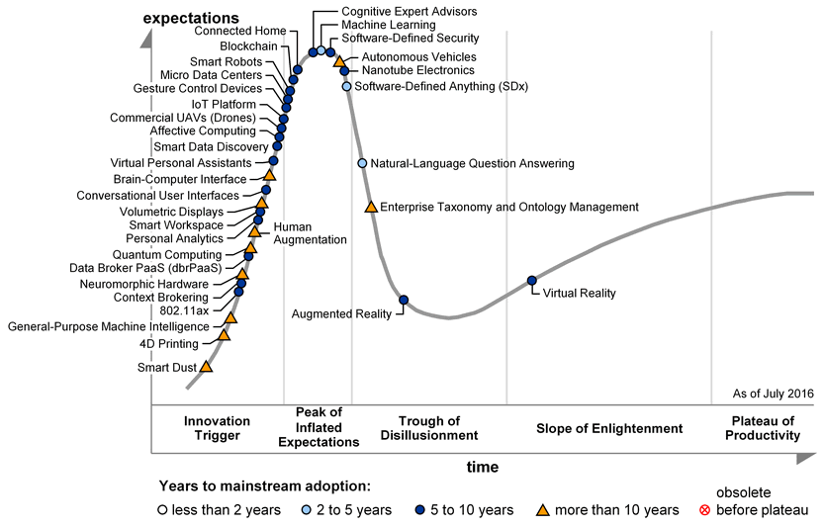
Why now: Financial Services is changing
Structural change capital,regulation, cost
Emergence of FinTech Startup’s
Hype Cycle: awareness, investment
Source: Business Insider The Fintech Ecosystem Report
Source: ECB challenges for European banking industry, 2016
Pattern – Shared data and process
Source: Gartner's 2016 Hype Cycle for Emerging Technologies
Source: On Distributed Communications Networks, Paul Baran, 1962
R3 Lab & Research Centre - confidential.
Notes:
The start of innovation development is driven by a hype initiated by very high expectations that the technology can solve human problems. The Internet also went through this development process, for example. In part, this technology was intended, as it later transpired, to revolutionize communication between people who were a long distance apart, with the Internet itself serving merely as a means to an end.

Slide 7
The R3 Ecosystem.
Clearing Houses
Sovereign Wealth
Asset Managers
Not-for-Profits
Reinsurance
Startup Community
Insurance
Technology Companies
Industry Organizations
Academic Institutions
Exchanges
Central
Banks
Banks
Regulators

Slide 8






Evolution from blockchains to Distributed Ledgers in Finance.
Meta Protocols, Colored Coins, and Tokenization
R3 Consortium begins
Corda open sourced
Bitcoin Release
2009
2015
Today
Altcoin Rush
Corda V1
Towards blockchain inspired technologies – DLT
Extends the concept in Bitcoin of ‘decentralized storage’ to ‘decentralized computer’
Notes:
The digital currency bitcoin is probably the best known application of Blockchain and is even better known than the Blockchain technology on which it is based. Bitcoin highlighted the potential of DLT and identifed other practical applications of the technology. The aim of bitcoin was to be decentralised, i.e. not have a point of control, and to be relatively anonymous.
The cryptocurrency is generated via a large number of Internet-linked computers (nodes) with the aid of a mathematical formula and recorded in a database that is managed decentrally by all participants. The currency can be transferred directly by means of peer-to-peer application, in other words without an intermediary. Encryption technologies ensure anonymity and ownership structures in the Blockchain.

Slide 9



How it works?
Distributed ledgers
Records of agreement(consensus),
with a secure (cryptographic) audit trail,
maintained and validated by several separate computers (network nodes).
Immutable Record
Consensus
Agreement mechanisms evaluate information provided by participants to ensure consent among all relevant parties in an entry
Visibility
When a transaction is added to the ledger, the network is almost-instantly privy to this new version
Distributed ledgers leave behind a cryptographically assured audit trail and timestamp
All parties in the network keep a copy of their view of the ledger
R3 Lab & Research Centre - confidential.
Notes:
Distributed ledgers typically include the following characteristics : shared ledger, cryptography, smart contracts, immutability // track record of ownership, and distributed consensus. Parties on the network (typically just the parties privy to a certain transaction) need to reach consensus on the outcome of a transaction before it is appended to the ledger. With a traditional blockchain, all mining nodes contribute to the next state of the ledger. With Corda specifically, only parties to a transaction have a say in the outcome.

Slide 10





Distributed Ledgers at a Glance.
Cryptography to ensure identity authentication for each transaction
Ledgers
Distributed Ledgers
Non-repudiation/immutability to preserve integrity of data and create an audit trail
Blockchains
Smart contracts for the automatic execution of business logic when certain criteria are met
Shared ledger so each participant sees the same view of the same data, updated in real time, subject to permissioning
Cryptocurrency
Distributed consensus to ensure the state of the ledger represents the agreed-upon truth of all stakeholders
Notes:
Smart contracts make it possible to exchange an asset without third parties being aware of the transfer. Users can allow doctors and other parties to view their medical records as required with their private key.
Cryptography (synonymous with encryption): Integrity of ledger, Authenticity of transactions, Privacy of transactions, Identity of participants

Slide 11
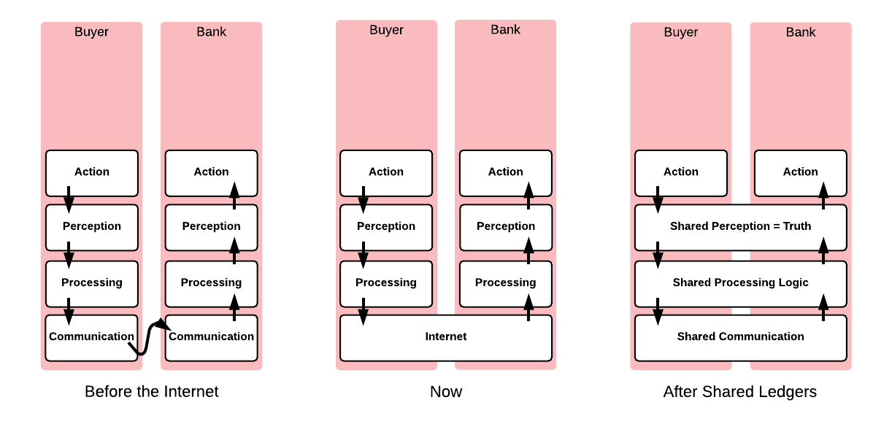


The Significant Evolutionary Step of DLT.

Slide 12




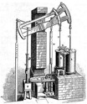


The Fourth Industrial Revolution.
4th
3rd
Confluence of emerging technologies
2nd
Computer, automation & networking
1st
Mass production, assembly line, electricity
Mechanization, water power, steam power

Slide 13
R3 Mission.
We are redefining the foundations of finance by harnessing the power of collaborative networks.

Slide 14




Benefits of Distributed Ledgers in Financial Markets
Distributed ledgers can replace legacy networks by validating, registering & tracking complex transactions in a dynamic, virtual and near real-time marketplace
Current State
Highly fragmented
Transactions take days to confirm and validate
Liquidity risk is pervasive
Regulatory reporting is onerous and suffers from human error
Future State
Unified by one ledger
Transactions validated in near-real time
Regulators can use the cryptographically assured audit trail made by the ledger passively
t+x
t+x
t+x
t+x

Slide 15
Public vs Permissioned Ledger.
Broadcast Blockchain
Corda DLT
Bank A’s Ledger
ID | Fact
1 | Bank A pays bank B $5.
2 | Bank B purchases bond X from issuing bank A.
3 | Bank C purchases bond X from bank B.
4 | Bank C enters a credit default swap with bank D.
5 | Bank D owes bank B $10.
Bank B’s Ledger
ID | Fact
1 | Bank A pays bank B $5.
2 | Bank B purchases bond X from issuing bank A.
3 | Bank C purchases bond X from bank B.
4 | Bank C enters a credit default swap with bank D.
5 | Bank D owes bank B $10.
Bank A’s Ledger
ID | Fact
1 | Bank A pays bank B $5.
2 | Bank B purchases bond X from issuing bank A.
Bank B’s Ledger
ID | Fact
1 | Bank A pays bank B $5.
2 | Bank B purchases bond X from issuing bank A.
3 | Bank C purchases bond X from bank B.
5 | Bank D owes bank B $10.
A
B
A
1
B
2
3
5
C
D
C
D
4
Bank C’s Ledger
ID | Fact
1 | Bank A pays bank B $5.
2 | Bank B purchases bond X from issuing bank A.
3 | Bank C purchases bond X from bank B.
4 | Bank C enters a credit default swap with bank D.
5 | Bank D owes bank B $10.
Bank D’s Ledger
ID | Fact
1 | Bank A pays bank B $5.
2 | Bank B purchases bond X from issuing bank A.
3 | Bank C purchases bond X from bank B.
4 | Bank C enters a credit default swap with bank D.
5 | Bank D owes bank B $10.
Bank C’s Ledger
ID | Fact
3 | Bank C purchases bond X from bank B.
4 | Bank C enters a credit default swap with Bank D.
Bank D’s Ledger
ID | Fact
4 | Bank C enters a credit default swap with Bank D.
5 | Bank D owes bank B $10.
R3 Lab & Research Centre - confidential
Notes:
Instead of having a fully public and uncontrolled network and state machine secured by crypotecomonies, it is possible to create a system where access is permissioned and more controlled.
-Securely cut out the middle man
-hides identity
Public advocates: freedom, neutrality and openess
Private: Kills part of whats purist favorite aspect of DLT (decentralization) but increases Security

Slide 16
The DLT Calendar.
2014 – The Year of Enlightenment
2015 – The Year of the Hype
2016 – The Year of the PoC
2017 – The Year of the Pilot
2018 – The Year of Production

Slide 17

Industry Business Case.
Financial Services spend $2.6 trillion annually on operating costs
Financial institutions spend approx. 15-20% of total costs on IT
Distributed Ledger Technology (DLT) could save $60-$80 billion across 4 use cases alone (AML/KYC, Cross-border payments, repos and OTC derivatives process)
Costly/inefficient KYC/AML management due to manual data collection/verification/monitoring
B2B cross border payments is costly, inefficient and not transparent
Fragmented, manual, non-standard OTC derivatives processing
‘Wait and see’ strategy is risky for market participants
Notes:
\

Slide 18
Centre of Excellence for Insurers
In partnership with the Association for Cooperative Research and Development (ACORD), a global nonprofit standards body, who’s goal is to improve data quality and information exchange for the insurance industry, R3 is launching a Centre of Excellence for Insurers & Reinsurers. The Centre will provide a dedicated environment for both R3 and ACORD’s members to research, experiment and design Distributed Ledger Technology (DLT) applications that improve the efficiency of insurance processes such as claims handling and data management.
Why Insurance?
Centre of Excellence Offering
Insurance involves many activities requiring contracts, claims filing, and payouts — DLT seems like a natural solution to automate many processes that are now manual, paper-heavy, slow, and error-prone
Insurance processes are often multi-party affairs, requiring a diverse range of players to reach a consensus — DLT's ability to give multiple parties access to a single, centralized record would prove especially valuable within the industry
Access to the R3 Wiki (a giant repository of research and resources collected by R3 members)
A dedicated insurance portal that will allow ACORD and R3’s members to discuss their DLT projects among themselves and with other industries
DLT education to C-suite, management, and technology personnel
R3 will also leverage its existing regulator contacts to run a regulatory outreach program, enabling ACORD members to invite relevant regulators to participate in and oversee any DLT projects initiated within the centre

Slide 19
Distributed Ledger’s in the Retirement Space
Margin pressures: Increasing as competition rises, causing a reduction in provider fees.
Transparency: employers and employees are demanding fee transparency and product simplication.
Consumers: Want to look at their retirement holistically and provide an integrated solution package.
Regulatory pressures
Changes in communication: digital technologies are changing how consumers interact, consume information and transact, as well as how providers develop products, sell them and service them.
R3 Lab & Research Centre - confidential.

Slide 20
Use Case: Plan and Record Management
Challenge: Retirement providers maintain a large number of plan documents such as plan contracts and service agreements. Documents are reviewed by multiple departments within the provider, and are then signed by responsible parties.
Benefits: Streamline plan document review process, Secure document storage, sharing of documents.
Client Discovery
Portfolio Construction
Monitoring & Rebalancing
0
1
2
3
4
Get client’s basic data
(Suggest changing to Disclosures)
Get client’s investment & risk profile
Define client’s investment objectives & its risk tolerance
Develop personalized, risk-verified optimized portfolios
Implement, monitor, report and rebalance portfolio
Client data
KYC
Financial situation (incl. risk ability)
Portfolio solution
Confirmation & trade execution
PRIIPS
Constraints & Preferences
Investment objectives
Optimal portfolio
Monitoring & rebalancing
Investor type
Risk tolerance
Preferences
(Instrument)
MIFID II - Best Execution
Investment
behavior
MIFID II - Suitability and
Appropriateness
Research
Payment
Accounts
MIFID II - Client
Categorization
private and confidential.

Slide 21
Insurance Pain Points, and R3 Solutions to Tackle Them
Information Gathering
Pricing and Underwriting
Payments
Claims
Regulatory Assessment
Manual/time intensive KYC information gathering
Fragmented data
Store client data/evidence of validation from issuing authority while enabling client to maintain control of records
Data security/integrity
Data access granted by consumer in real time
KYC Theme
LEIA
Heatwave
Poor risk profiling
Lack of integration with new modeling processes
Smart contract-enabled underwriting process executed by insurer to fetch customer data from third party system/oracle
Reduced identity/claims fraud thereby lowering rates and increasing coverage
Asset Modeling Theme
Project Sentinel
(adaptable to insurance)
Poor invoicing, billing, and payment validation
Instant transfer of currency asset
Reduce cost and increase speed of payments
Cash Theme
Xenon
Claims processing very manual, requiring extensive central validation (subjectivity and errors)
Smart contract executes policy conditions with claim process and shares report with claims administration for final settlement
Reduce fraud and claims administration
Improve identification of claim events
Insurance Theme
Sibi
Reference Data Theme
Project Conrad and Camelot
Regulatory filings duplicate existing work, paper-based
Real-time access to regulators
Solvency surveillance via real time remote auditing
Reduce administration costs
Regulatory Theme
Maison
Pain Point
DLT Use Case
Benefit
R3 Related Projects
R3 Lab & Research Centre - confidential

Slide 22




Illustrative Applications Leveraging DL Technology.
Distributed ledger technology has a multitude of potential applications
Financial Institutions
Regulators
Operations
Individuals
Cross Border Payments
Anti-Money Laundering / Know Your Client
Derivatives Clearing
Repo Clearing
Claims Processing
FX Settlement
Loan Settlement
Collateral Management
Anti-Money Laundering / Know Your Client
Compliance Reporting
Risk Visualization
Basel III Compliance
Client Fund Transparency
Trade Reporting
Client Onboarding
Intracompany Settlement
Normalize Reference Data
Timestamping
Account Portability
Broker Fraud Identification
Securities Agreements as Smart Contracts
Virtual Identity
Credit Scoring
Cross Border Remittance
Vault/Escrow Services
Customer Deposit Cost
Peer-to-Peer Insurance and Lending
Four of the high-potential FI use cases could alone generate $60-80bn in cost savings
Source: McKinsey 2016 Findings From Research Into Distributed Ledger Technology

Slide 23
R3’s Vision and Path.
Global presence Cross-industry use cases Proven Collaboration 200+ Members
✓
✓
✓
LRC Community & Project Collaboration
Path Towards Production
R3 Expansion Strategy
Proof of Concepts
Prototypes
Pilot
Permission
Production
Projects
Vendors
200+
100+
IN FINANCIAL SERVICES
BLOCKCHAIN INNOVATION
- DLT - AI - Cloud - Big Data
CENTER OF GRAVITY
Technology
- FI - Insurance - Healthcare - Auto
Separate Member Use Cases shows additional learning
Non-R3 projects with members expected
Industry
80+
2,500+ contacts
Growing Dev Community
Focus on Enterprise Integration
Services
Members
- Research - Infrastructure - Whitepapers - Education - …
Reusable Components
Repeatable Projects to other Regions and industries
Shared Lessons / Reviews

Slide 24
R3 Vision.
We will revolutionize outdated infrastructures to create shared truths that enable anyone to contract seamlessly and without error for any purpose.
R3 Lab & Research Centre - confidential

Slide 25
Appendix

Slide 26





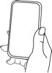


How DLT Can Improve Processes.
Identity on a DL
Insurance Verification on a DL
Golden Copy
Patient arrives at Doctor’s office
Biometric fingerprint scan identifies patient and sends identity information located on DL to office admin team
Proof of insurance is tied to identity and is stored with it on the ledger
As patient is identified, insurance information is sent to office admin team
Patient authorizes release of golden copy medical records to doctor
Doctor reviews records
Patient Receives Treatment
After review of medical records, doctor assesses condition
Doctor prescribes medication and writes script
Script entered onto ledger, which is accessible by Rx once patient authorizes
Medical records are updated
Smart Contract
Identity & Insurance on a DL
Smart Contract & Real Time Payment
Patient Releases Script
Patient releases prescription to preferred Rx, requesting it be filled
Once prescription is filled, a smart contract sends an alert to patient
Patient uses biometric iris scan at pharmacy
Identity is verified to Rx
Insurance information is sent to Rx
Smart contract determines copay based on legal prose within insurance plan
Bank account, which is linked to identity, releases copay in real-time
Receive prescription
RELEASE
READY

Slide 27


Blockchain/DLT Primer
Blockchain is a ledger distributed across a network (e.g., the Internet) and available to all users in the network to view and edit the transactions in a secure way using cryptography technology.
Each transaction is registered in the ledger building the history of that particular transaction, and validated for its authenticity by the users.
Blockchain provides integrity, auditability, governance and transfer of ownership capabilities. This provides businesses with faster and more efficient processing, lower cost of operation and greater resilience against system failure.

Slide 28
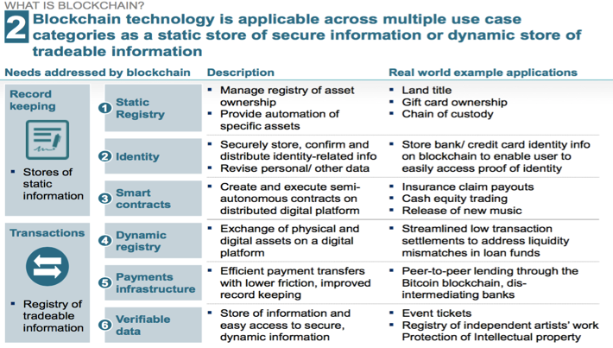
McKinsey Report on DLT.

Slide 29
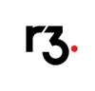
What does R3 do?
Platform
Services

Slide 30

A unique shared ledger approach
Blockchain-inspired: takes best attributes from Bitcoin, Ethereum, and others.
Consensus: achieved at individual deal level, rather than system level. Supports a variety of consensus mechanisms.
Enterprise grade: built specifically for financial markets.
Regulator-focused: design directly enables regulatory/supervisor observer nodes.
Data privacy: transactions info propagated only to relevant nodes.
Smart contract: strong link between legal prose and smart contract code.
Easy integration: reuse existing developer skills and make integration with bank systems easy and safe. Query and join the ledger to existing DBs with SQL, and code contracts in modern, standard languages like Java.
Internet Economy Summit HK 2017

Slide 31
R3 Platform Vision.
CorDapps
(“Top of Stack” Corda-Based Applications)
R3Net Services
Corda Enterprise (Proprietary)
Corda Core Components (Open Source)

Slide 32

Ryan Rugg, Director of Business Development
Email: Ryan.Rugg@R3.com

Slide 33
Questions.
Ryan Rugg, Director of Business Development
Email: Ryan.Rugg@R3.com

